Slide 1











EMOTIONS

Slide 2
Low-intensity, long-lasting emotional state
Mood is something that you may not express whereas an emotion can be expressed
When compared to moods, emotions are more extreme
Emotions are aroused in people by some specific objects or situations. On the other hand, moods are not created in someone because of any specific object or any particular situation
Emotions & Moods

Slide 3
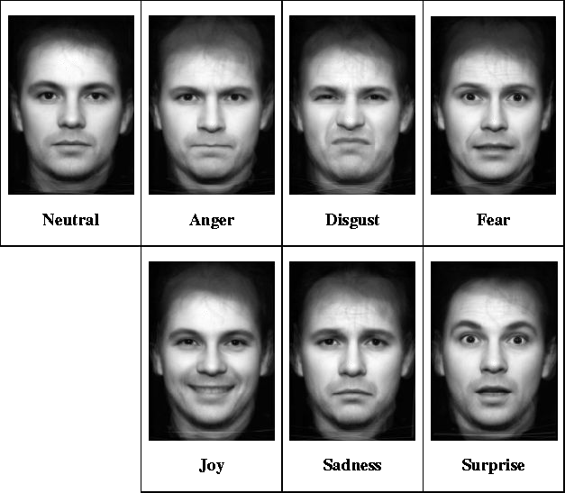
Ekman (1973) found that people in many different countries all have very similar facial expressions for 6 basic emotion

Slide 4
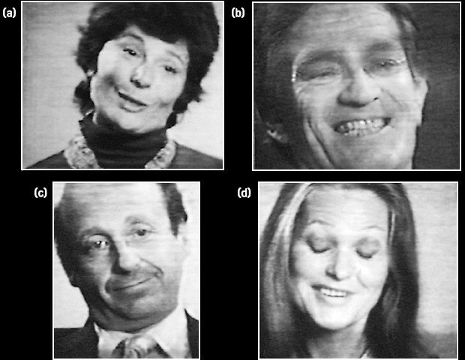
Smiles can show different emotions:
Mask anger
Overly polite
Soften criticism
Reluctant compliance
Expressing Emotions

Slide 5
Physiological Theories
James Lange Theory
Cannon Bard Theory
Cognitive Theories
Schachter-Singer Theory
Theories of Emotion

Slide 6
An event causes physiological arousal first and then we interpret this arousal. Only after our interpretation of the arousal can we experience emotion.
If the arousal is not noticed or is not given any thought, then we will not experience any emotion based on this event.
James-Lange Theory of Emotion

Slide 7






Sight of oncoming car
(perception of stimulus)
Pounding heart (arousal)
Fear (emotion)
James-Lange Theory of Emotion

Slide 8


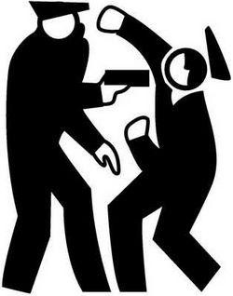
You are walking down a dark alley late at night. You hear footsteps behind you and you begin to tremble, your heart beats faster, and your breathing deepens.
You notice these physiological changes and interpret them as your body's preparation for a fearful situation.
You then experience fear.
James-Lange Theory of Emotion

Slide 9

The Cannon-Bard theory argues that we experience physiological arousal and emotional at the same time, but gives no attention to the role of thoughts or outward behavior
The Theory states
“An emotional stimulus produces two concurrent reactions, arousal and experience of emotion, which don't cause each other”
Cannon-Bard Theory of Emotion

Slide 10







Pounding heart (arousal)
Sight of oncoming car
(perception of stimulus)
Fear (emotion)
Cannon-Bard Theory of Emotion

Slide 11
You are walking down a dark alley late at night. You hear footsteps behind you and you begin to tremble, your heart beats faster, and your breathing deepens. At the same time as these physiological changes occur you also experience the emotion of fear.
Cannon-Bard Theory of Emotion

Slide 12
According to this theory, an event causes physiological arousal first. You must then identify a reason for this arousal and then you are able to experience and label the emotion
Schachter-Singer Theory of Emotion

Slide 13








Pounding heart (arousal)
To
experience emotion one must:
be
physically aroused
cognitively label the arousal
Sight of oncoming car
(perception of stimulus)
Fear (emotion= labeled aFroeuarsal)
(
emotion=
labeled arousal)
Cognitive label
“I’m afraid”
Schachter-Singer Theory

Slide 14
You are walking down a dark alley late at night.
You hear footsteps behind you and you begin to tremble, your heart beats faster, and your breathing deepens. Upon noticing this arousal you realize that is comes from the fact that you are walking down a dark alley by yourself. This behavior is dangerous and therefore you feel the emotion of fear.
Schachter-Singer Theory of Emotion

Slide 15
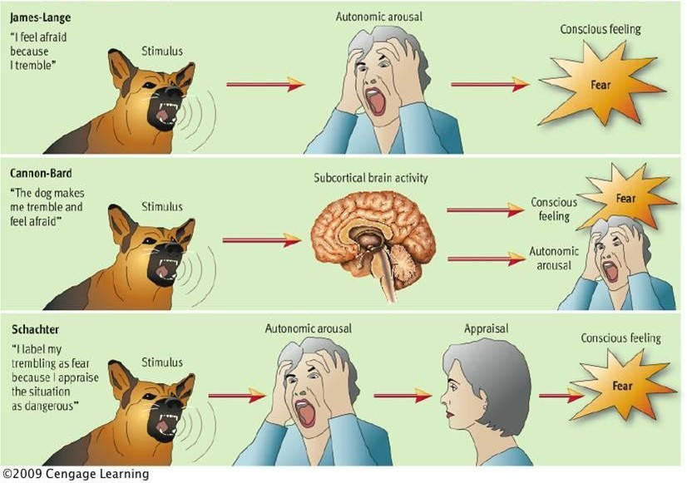

Slide 16
Emotion is the experience of changes in our facial muscles
In other words, when we smile, we then experience pleasure, or happiness. When we frown, we then experience sadness
It is the changes in our facial muscles that cue our brains and provide the basis of our emotions
Facial Feedback Theory of Emotion

Slide 17
You are walking down a dark alley late at night. You hear footsteps behind you and your eyes widen, your teeth clench and your brain interprets these facial changes as the expression of fear.
Therefore you experience the emotion of fear.
Facial Feedback Theory of Emotion

Slide 18
Both positive and negative emotions can be functional or dysfunctional
Functional emotions are those that are adequate to
Place
Time
Situation
Very often only expression (or its hiding) can be dysfunctional
Functionality/Dysfunctionality
Of Emotions (Ekman & Davidson, 1994)

Slide 19
Adaptation
Motivation
Communication
Information for oneself (feelings, thoughts)
but sometimes recognition of own emotion is inaccurate
Information for others (expression)
Can serve as basis for judgments and decisions
Influences attention and memory
Influence information processing.....
General Functions of Emotions

Slide 20


Emotional Labor and Emotional Intelligence
Workplace Emotions

Slide 21
Effort, planning and control needed to express organizationally desired emotions during interpersonal transactions.
Emotional labor higher when job requires:
frequent and long duration display of emotions
displaying a variety of emotions
displaying more intense emotions
Emotional Labor

Slide 22
Displaying or hiding emotions varies across cultures
Minimal emotional expression and monotonic voice in Korea, Japan, Austria
Encourage emotional expression in Kuwait, Egypt, Spain, Russia
Emotional Labor Across Cultures

Slide 23
Difficult to display expected emotions accurately, and to hide true emotions
Emotional dissonance
Conflict between true and required emotions
Potentially stressful with surface acting
Less stress through deep acting
Emotional Labor Challenges

Slide 24
Ability to perceive and express emotion, assimilate emotion in thought, understand and reason with emotion, and regulate emotion in oneself and others
Emotional Intelligence Defined

Slide 25
Model of Emotional Intelligence
Relationship Management
Managing other people’s emotions
Highest
Social Awareness
Understanding and sensitivity to the feelings, thoughts, and situation of others
Self-management
Controlling or redirecting our internal states, impulses, and resources
Self-awareness
Understanding your own emotions, strengths, weaknesses, values, and motives
Lowest

Slide 26
Emotional Intelligence Competencies
Self (personal competence)
Other (social competence)
Self-awareness | Social awareness
Self-management | Relationship management
Recognition of emotions
Regulation of emotions

Slide 27
Emotional intelligence is a set of competencies (aptitudes, skills)
Can be learned, especially through coaching
EI increases with age -- maturity
Improving Emotional Intelligence

